Slide 1
Restaurant online Food Ordering System
Digital Circuit Design Lab –Mini Project
GROUP:
Pooja Gupta
P. Anjali Pravallika
Srinidhi

Slide 2
WHAT IS VERILOG?
Verilog is a HARDWARE DESCRIPTION LANGUAGE (HDL). It is a language used for describing a digital system like a network switch or a microprocessor or a memory or a flip−flop. It means, by using an HDL we can describe any digital hardware at any level. Designs, which are described in HDL are independent of technology, very easy for designing and debugging, and are normally more useful than schematics, particularly for large circuits.
Verilog supports a design at many levels of abstraction. The major three are-
Behavioral level
Register-transfer level
Gate level
Now lets design our project using VERILOG!

Slide 3
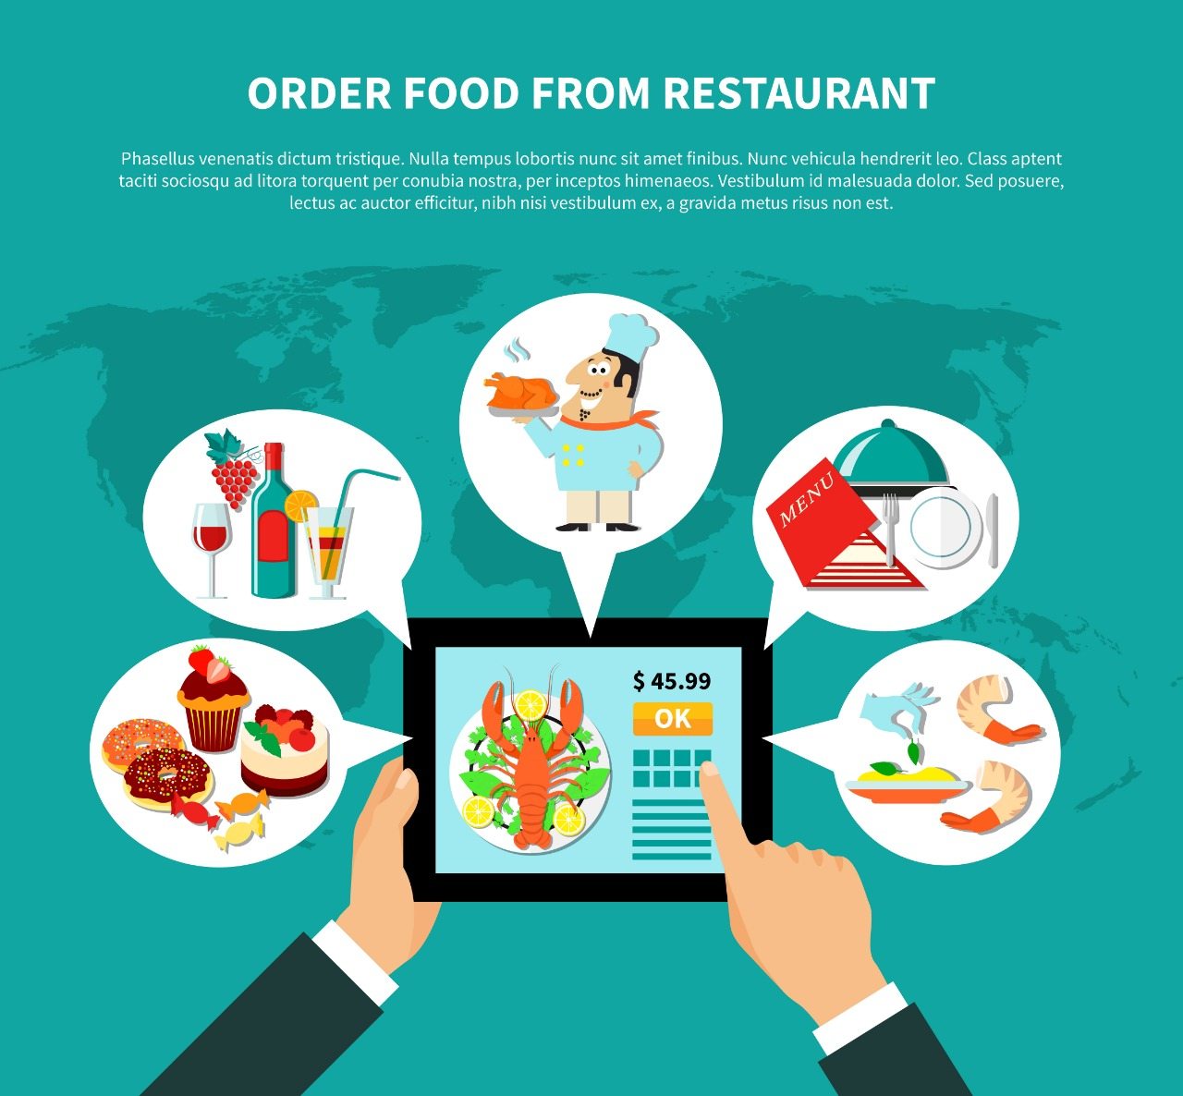

Slide 4
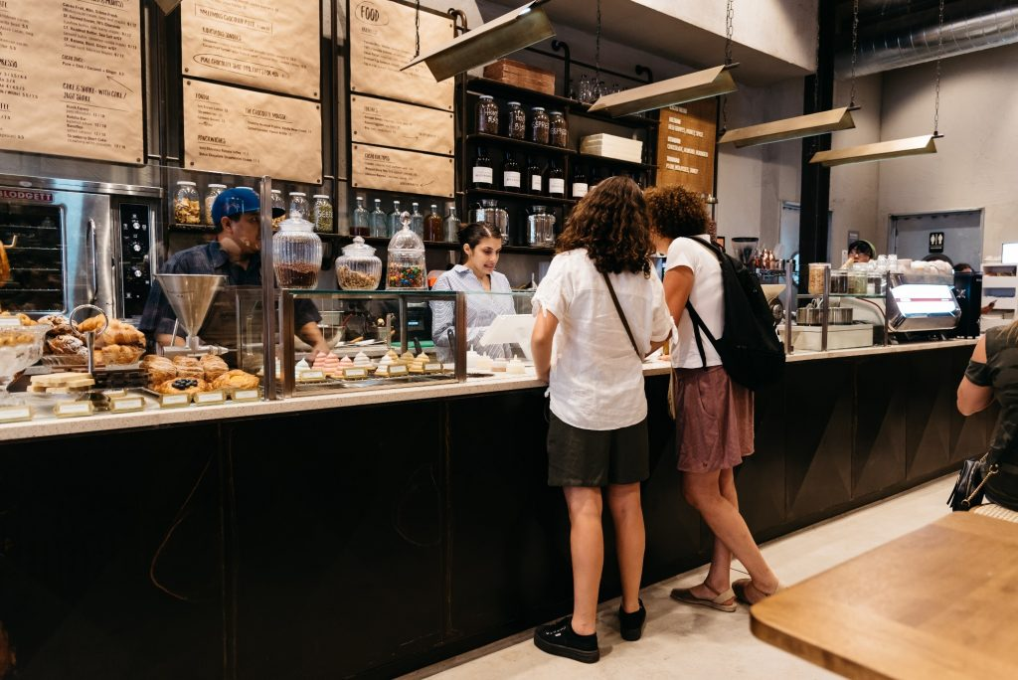
Nowadays, people are more regularly dine-in at restaurants for their meals. The online food ordering system provides convenience for customers that are nothing special but the generally busy people of society. RESTAURANT FOOD ORDERING overcomes the demerits of the manual hotel or mess system and the old-fashioned queuing system. This system enhances access to readymade foods for people.

Slide 5
INTRODUCTION
In almost all restaurants, we order food using its menu card in which all the available items are listed. Nowadays, Digital multi-touch menu cards in restaurants are replacing traditional services. In traditional restaurants, orders are taken by waiters and they bring the food when it is ready, later the customers pay the bill to the waiter or to the accountant at the reception area. Also, home delivery orders are noted down on paper and can even contain errors in the address noted. This system relies on large numbers of manpower to handle customer reservations, ordering of food, placing of orders on the respective table, reminding orders of the customer, delivering of food, and billing. Therefore, ways to effectively improve the service quality for customers by using advanced technologies have received much attention in recent years. Errors in ordering processes lead to incorrect or out-of-sequence meal preparation and result in added costs to the business.
This project aims to deliver an automated table ordering system. Herein, in the hotel, the order will be placed digitally through a touch screen module i.e the tablet. This order will be communicated through a wireless medium to the kitchen as well as will be updated in the central database. A similar display will be present in the kitchen and according to the customer's order, the catering staff will prepare the food. Once the order is ready in the kitchen, the waiter will be notified about it being ready to be served.

Slide 6
EXISTING SYSTEM
PROPOSED SYSTEM
The traditional paper-based system all records are stored on paper. However, this system is plagued with various problems. Some of the problems are highlighted below:
The most common blunder is waiters making mistakes with customers’ orders.
Customers have to wait for a waiter to take their order. Their food may take longer to be prepared and served if the waiter has multiple tables. They may also get the wrong bills.
Impatient customers also call over the waiter frequently to find out the status of their order, wasting the waiter's service time. In the
The above-mentioned traditional menu ordering systems are time-consuming and susceptible to human errors which can only be reduced, not completely eliminated. The problem with the self-service ordering system is that self-service restaurants are more popular in metro cities.
Comparatively, in smaller cities, there are hardly any self-service restaurants available. Comparatively self-service systems are very rarely found in small cities. Our aim is to develop a cost-effective system that can work affordably in smaller restaurants too.
This system aims at creating a user-friendly interface, service navigation, and low cost, increasing the service range of wireless communication used and decreasing the order processing time, reducing the paperwork and the human errors in it. As a remedy for the traditional systems, we propose an online restaurant food ordering system.

Slide 7
EXISTING SYSTEM
PROPOSED SYSTEM
Waiters need to constantly check with the chefs to determine when food is ready. Conversely, the chef needs to make sure waiters know that food is ready. This can cause the food to get cold over time and lead to potential food poisoning. It may also lead to wrong orders and an unsatisfied customer.
Keeping track of empty, clean and reserved tables within a restaurant.
Waiters must always be alert as to which tables need clearing. This means that they must be always checking for tables. Waiters need to usually alert them. This takes extra time from other staff.
Managers have to analyze hundreds of paper receipts to determine best-selling items, popular hours and customer satisfaction.
Our system aims at providing the following features:
Combining Wireless technology and Android OS to automate the food ordering process.
Allow the restaurant to operate faster (faster seating, faster order preparation, faster turnaround on food.
Reduce employee error, thereby increasing customer happiness. This also reduces waste as when the wrong item is ordered, the food must be discarded.
To minimize the flaws in a conventional system by atomizing the working of a restaurant.
To provide a mechanism for obtaining feedback from the customers and provide the restaurant a means of review of their service

Slide 8
SYSTEM ARCHITECHTURE
The architecture covers the three main modules: the Customer Login, the Menu and the Payment section. Conceptually this system is built using three main components
The android application on the smartphones.
The server application on the restaurant manager's laptop/tablet to customize keep track of customer records, table bookings and time required to reach.
The central database for restaurant-owner to store updated menu information, customer information and order details.

Slide 9
Modules
LOGIN- User details have been stored in a database. As soon as the customer opens the tablet he will get the login page where he will have to enter his phone number as the username and his password.
MENU- After this, he gets the menu page in which firstly he gets the option of veg or non-veg. After this, he gets the option to select items in each of the options to select the items he wants to order.
PAYMENT- After the successful selection of the item now he has the option to place the order. Now the bill of users will be prepared according to the items selected. Here the tax is already included in the cost of the dish. Then the payment is done by the user.

Slide 10
SYSTEM FLOW
Our main aim is to increase the efficiency of the food ordering system and reduce human errors. The application on the tablets must be able to communicate wirelessly with the other devices. Fig. shows the dining section that is a waiter with a mobile placing an order. Firstly the person at the reception is empowered to allow the suitable of table(s) to the customers.
The customer logins in the tablet kept on the table and logins using his phone number and password then orders.
The orders are then sent to the kitchen via Wi-Fi.
The kitchen staff sends a notification whether the food is available or not.
When the kitchen staff sends a notification that the food has been prepared, the waiter in the kitchen serves the food at the respective table.
Then after finishing bill is displayed on the tablet for the customer to pay.

Slide 11
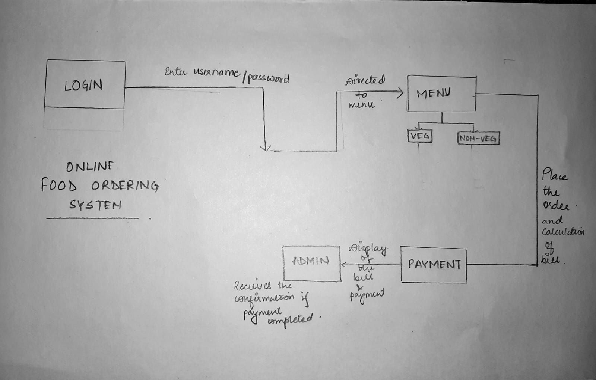

Slide 12
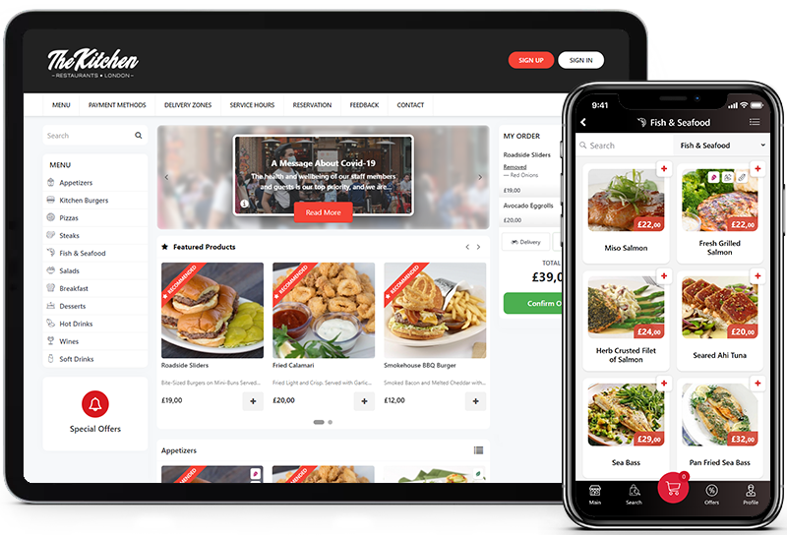

Slide 13
LOGIN_PAGE:
As from above, we started building the login page first, Every user has a different login id and password. Every customer will have an account to which they can log in or if a new customer comes they can create an account and then place an order. We created a database for the customers where they have login_id or username and also a password. To make it safer and much easier to remember for the customer, they can give their cell phone number as login_id or username.

Slide 14
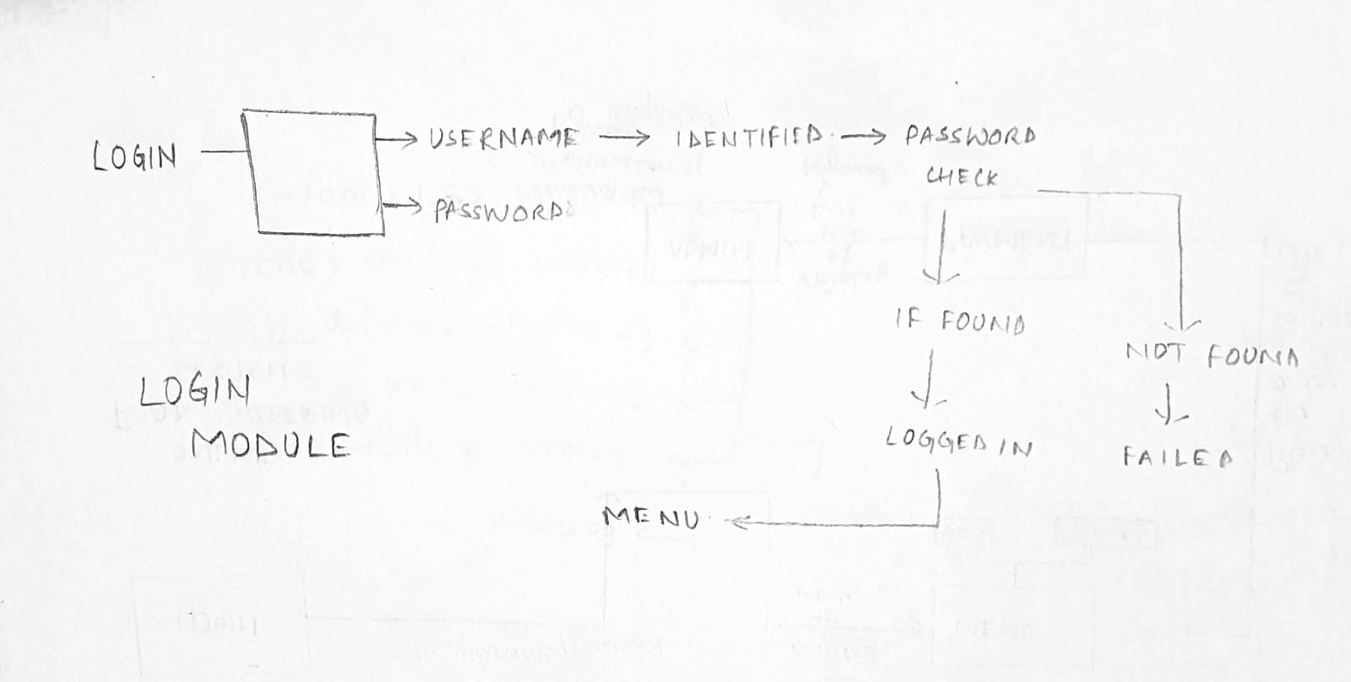

Slide 15
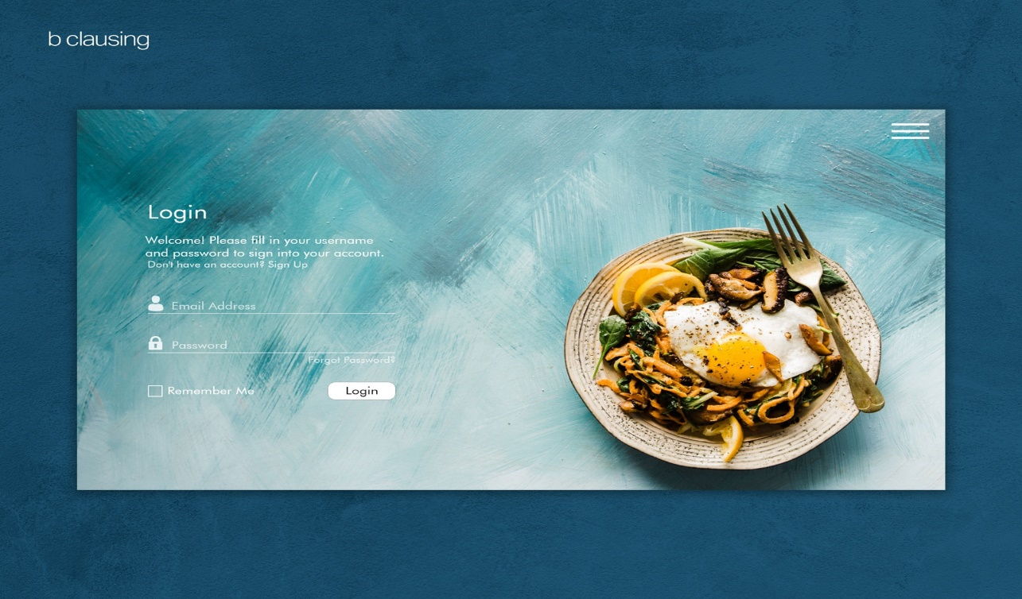

Slide 16
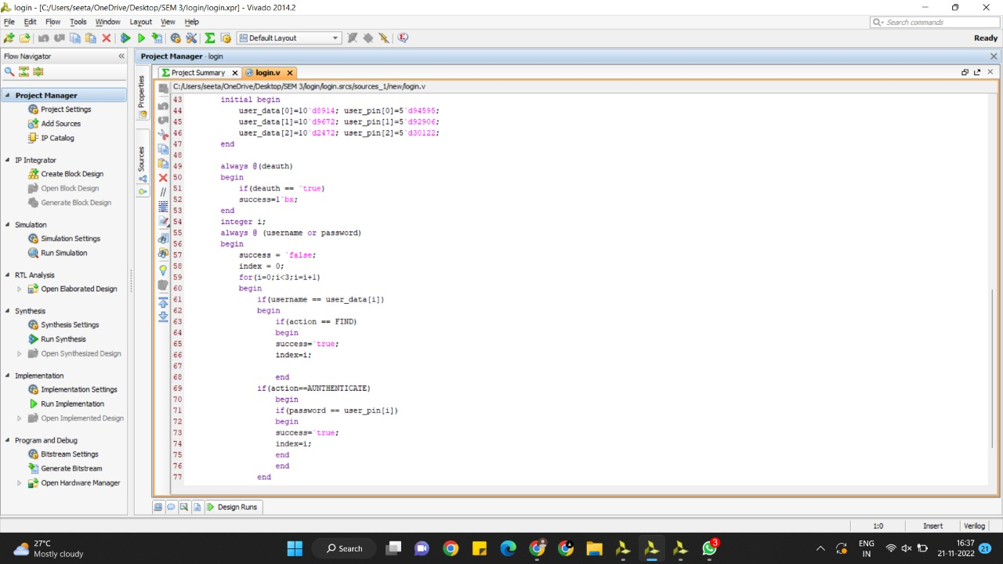
OUR CODE:

Slide 17
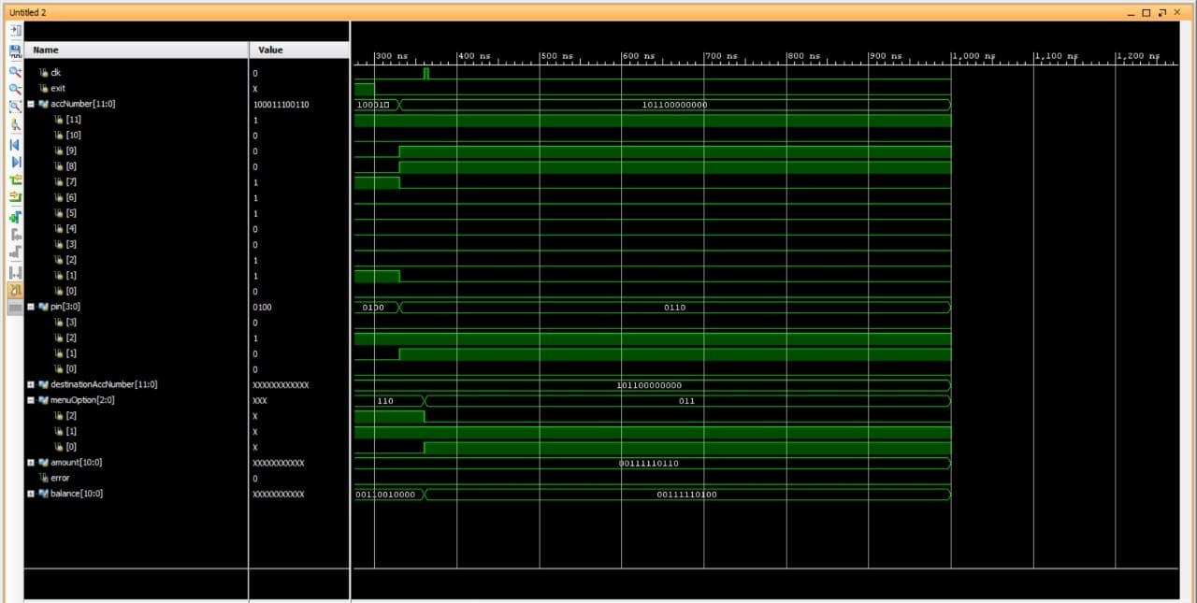
SIMULATION:

Slide 18
MENU:
The menu module consists of the key features of this app, here we have provided facilities to the customers such that they can select the options or items they wanted. They can select single or multiple dishes they require. There are especially two divisions in dishes which are veg and non-veg. In the veg or non-veg, there are five divisions or types of dishes.
Menu – VEG and NON-VEG

Slide 19
VEG – 1. Paneer Fried Rice, denoted as item-0 and costs 100/-
2. Butter Naan, denoted as item-1 and costs 200/-
3. Special Fried Rice, denoted as item-2 and costs 300/-
4. Veg Biryani, denoted as item-3 and costs 400/-
5. Panner Butter Masala, denoted as item-4 and costs 500/-
NON-VEG – 1. Chicken Biryani, denoted as item-5 and costs 600/-
2. Chicken Fried Rice, denoted as item-6 and costs 700/-
3. Chicken Lollipop, denoted as item-7 and costs 800/-
4. Chicken Masala, denoted as item-8 and costs 900/-
5. Chicken 65, denoted as item-9 and costs 1000/-
In the menu, the person is free to choose the required item, after the selection the item selected will be displayed to the admin who takes the orders that this person selected. The administration makes sure that if a certain item is not available then the option will be removed.

Slide 20
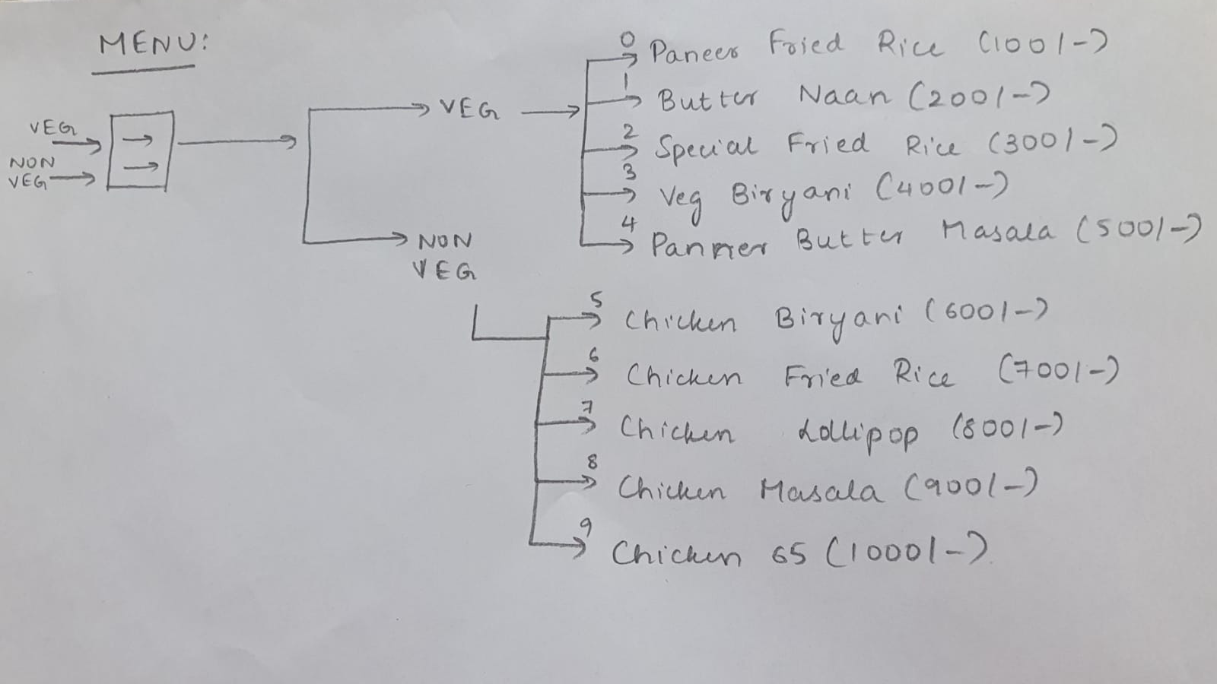

Slide 21
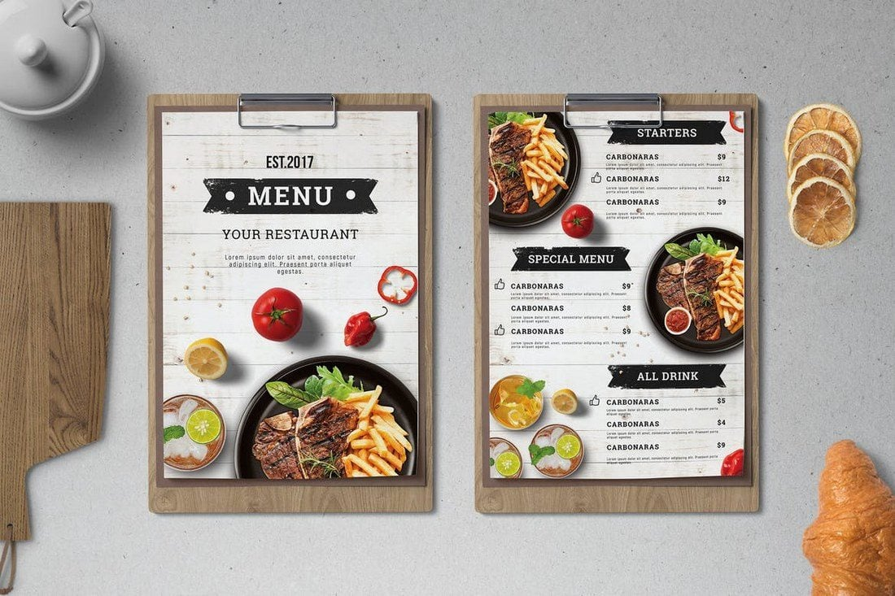

Slide 22
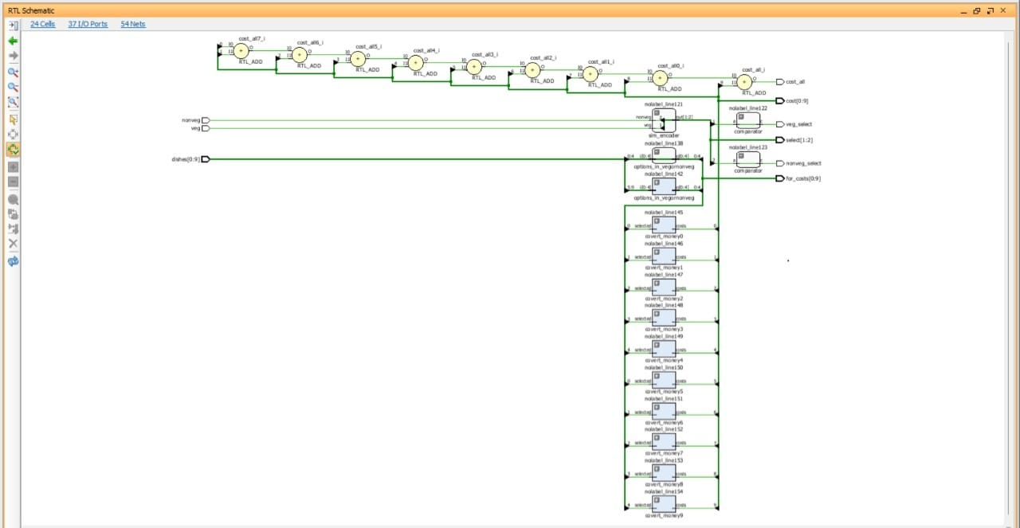
SCHEMATIC:

Slide 23
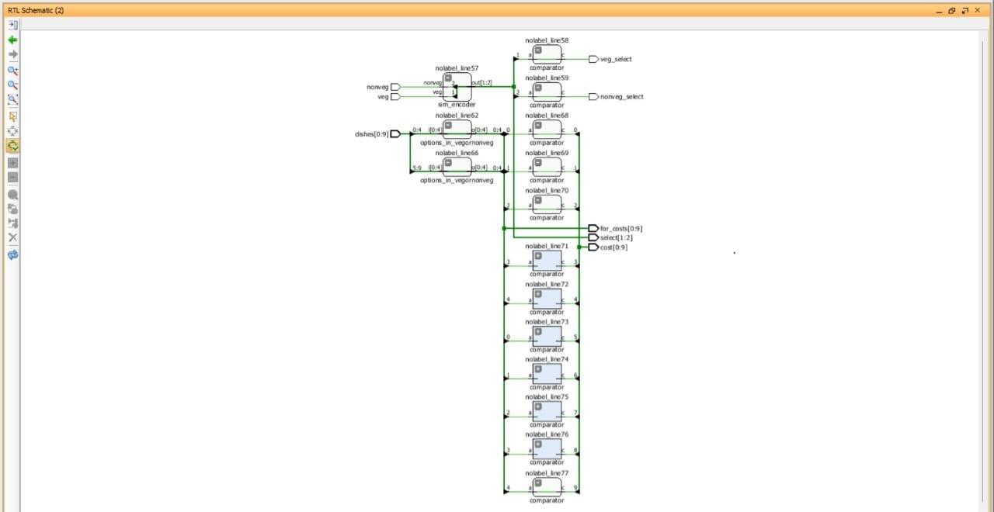
SCHEMATIC:

Slide 24
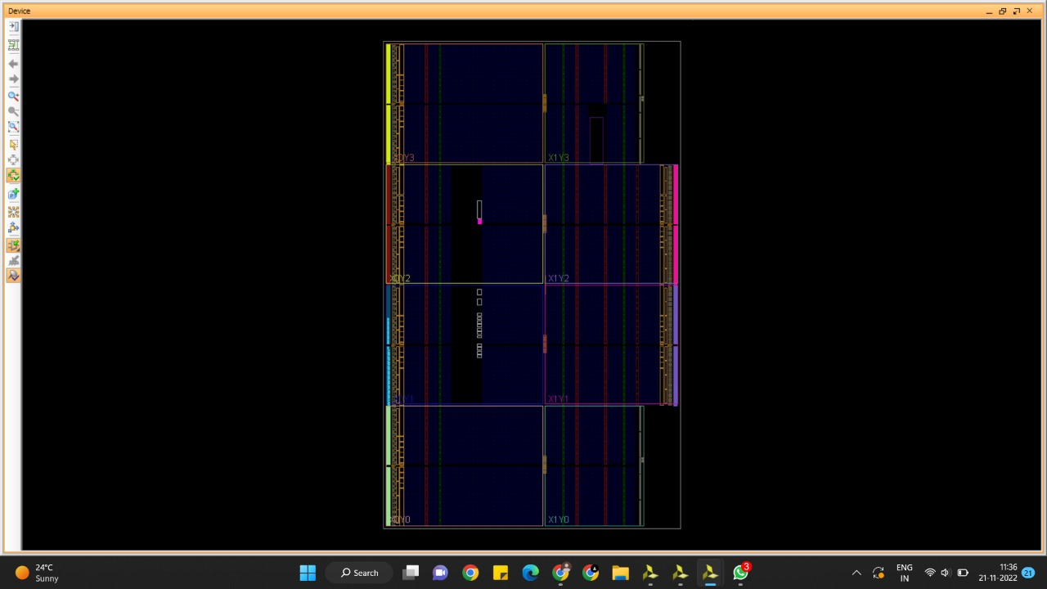
NETLISTS:

Slide 25
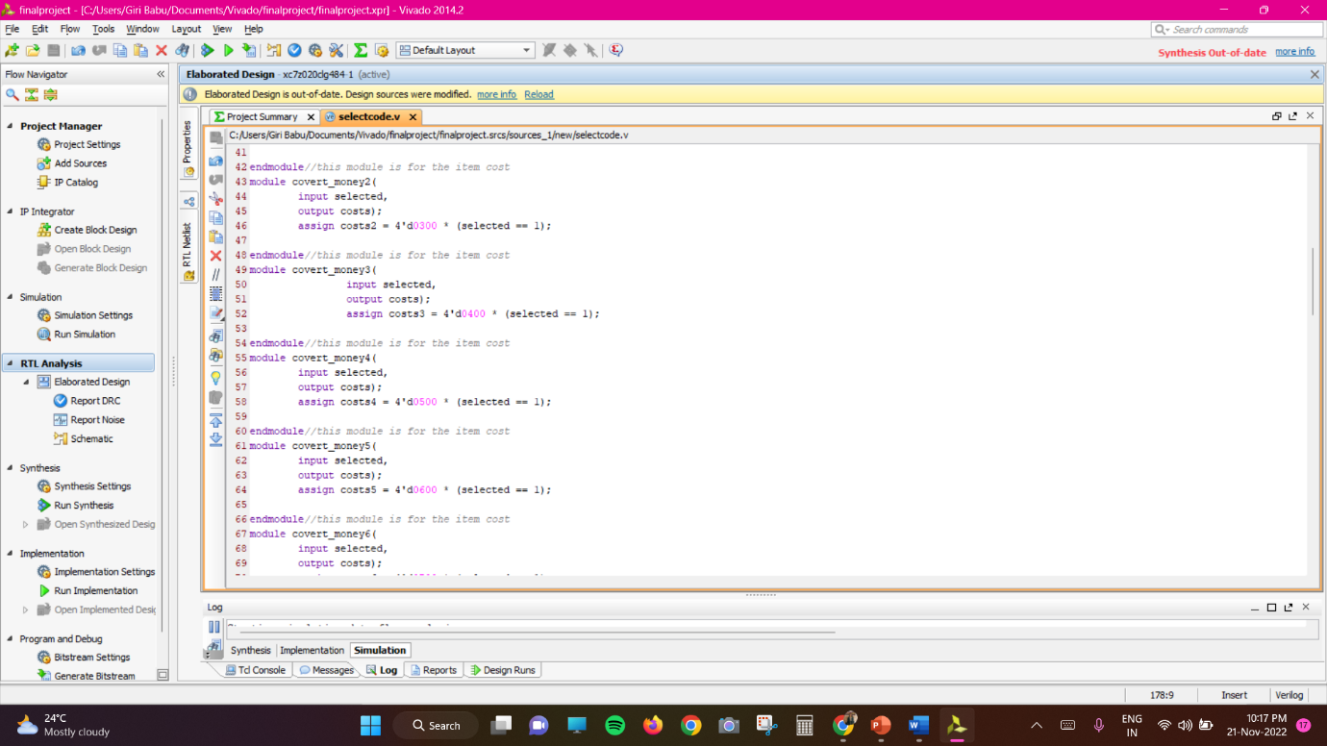
OUR CODE:

Slide 26
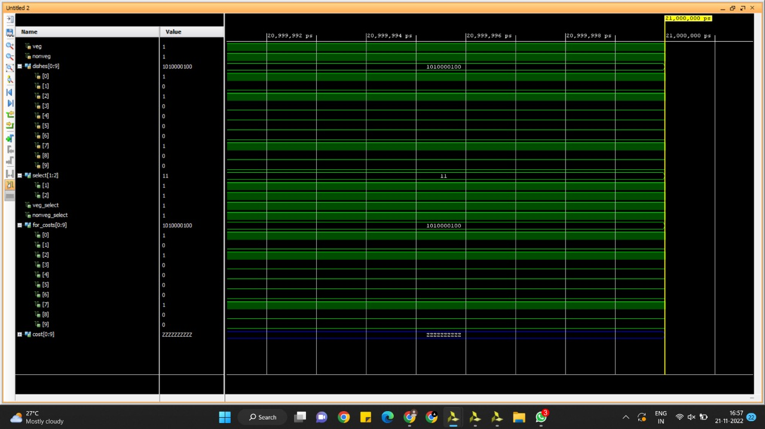
SIMULATION:

Slide 27
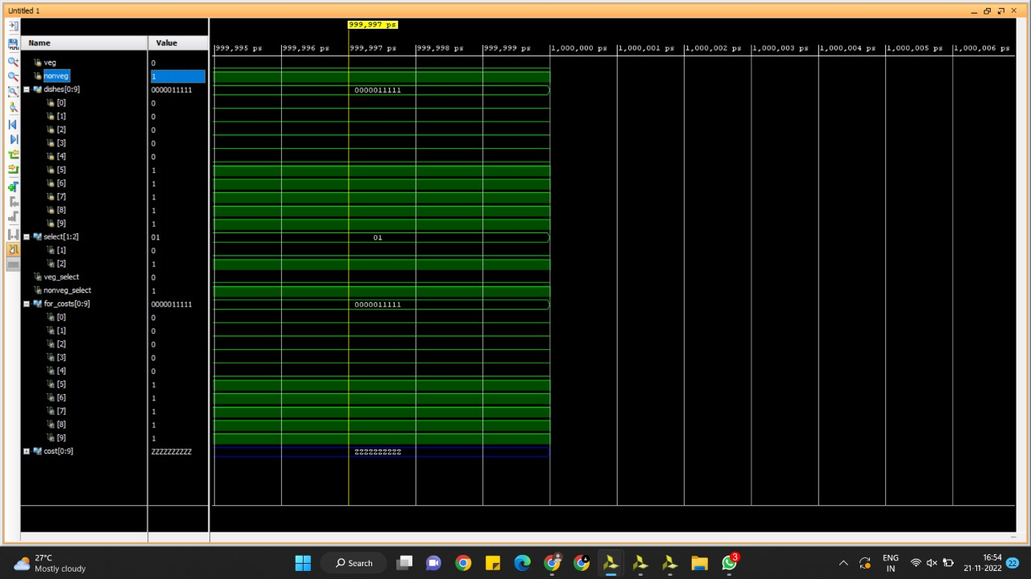

Slide 28
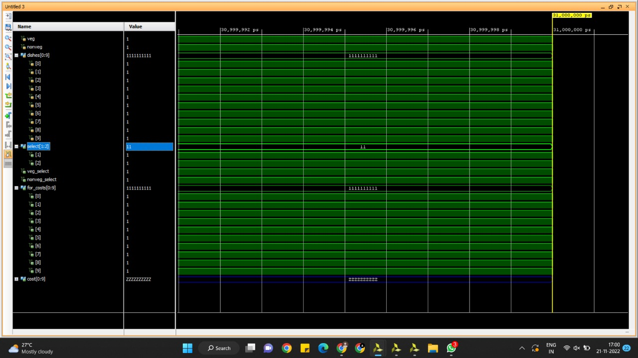

Slide 29
PAYMENT:
Payment is for displaying the total amount they have to pay after serving the items. If the customer wants to give a tip to the waiter they can include it in the total payment. The module is convenient enough to let the customer pay the money offline or online. If the mode is offline then the module exists, if online then he has to pay. There is one more advantage to visiting often to the restaurant as the prayer payment the person can give them an offer of 500/- off or etc, depending on the before-visit payment. This data is stored in the database.

Slide 30
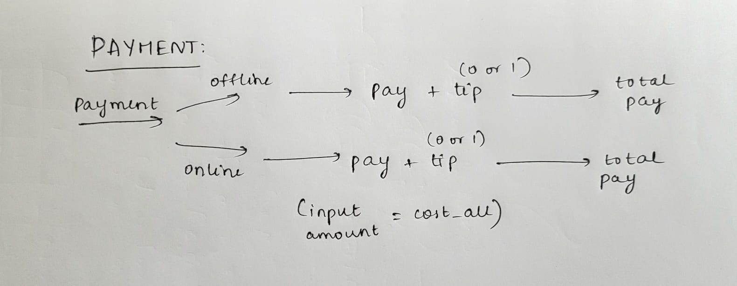

Slide 31
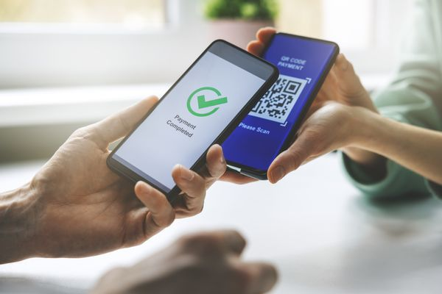


Slide 32
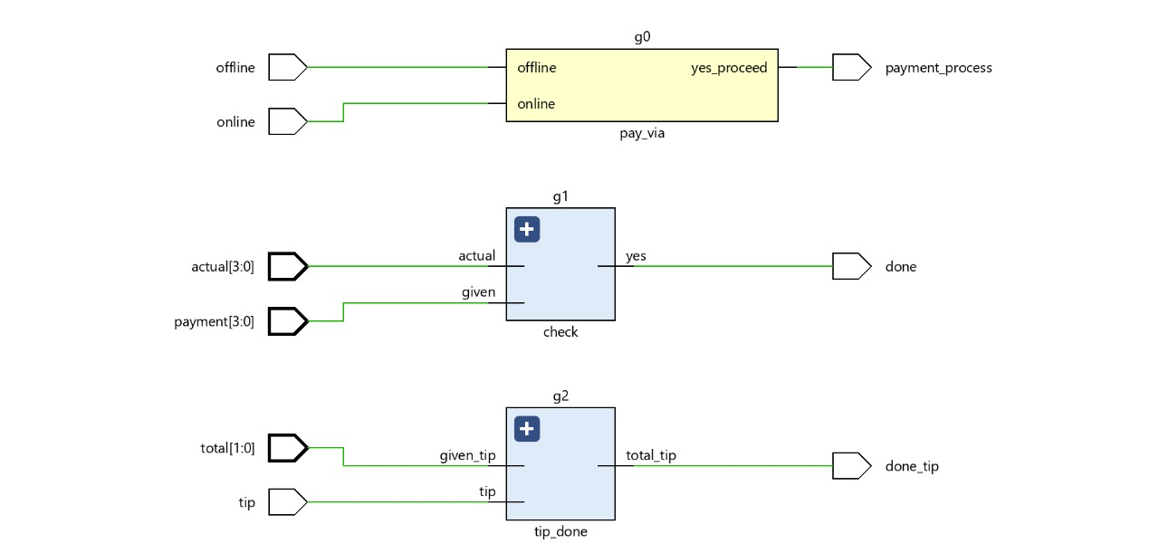
SCHEMATIC:

Slide 33
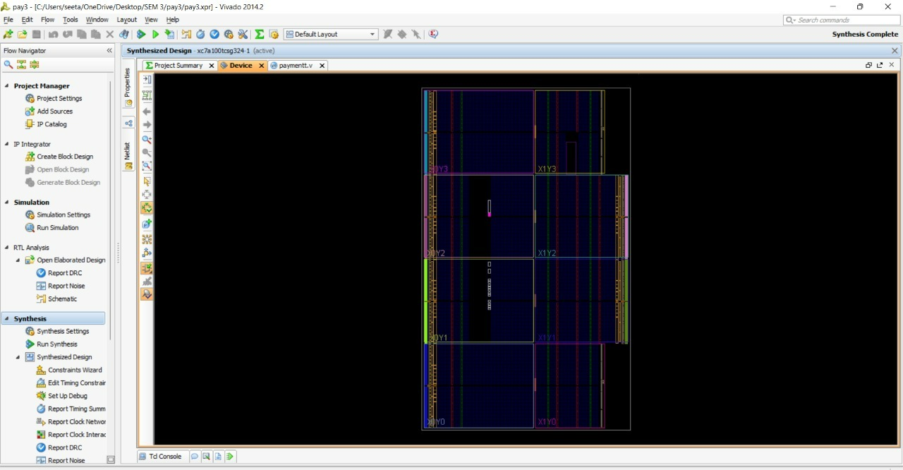
NETLISTS:

Slide 34
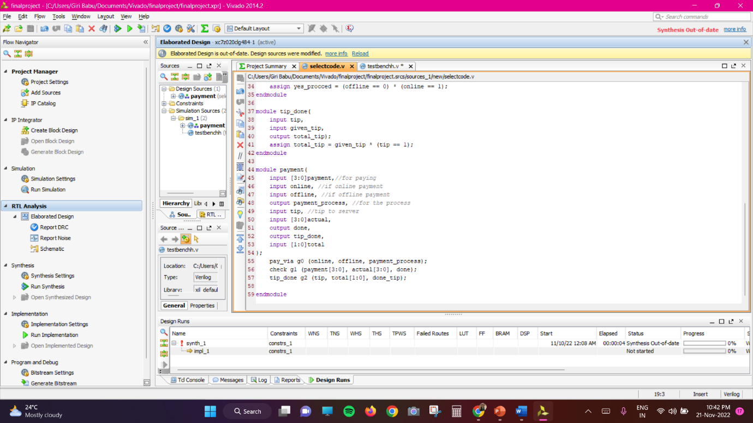
OUR CODE:

Slide 35
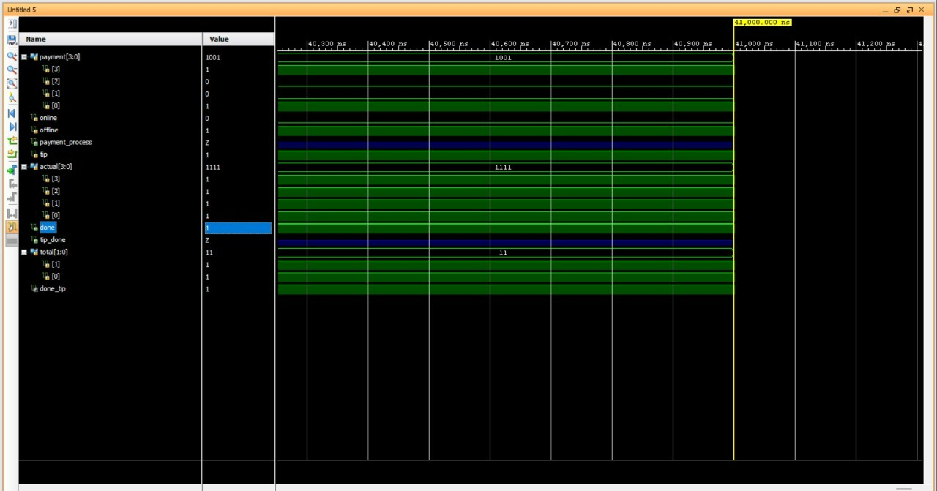
SIMULATION:

Slide 36
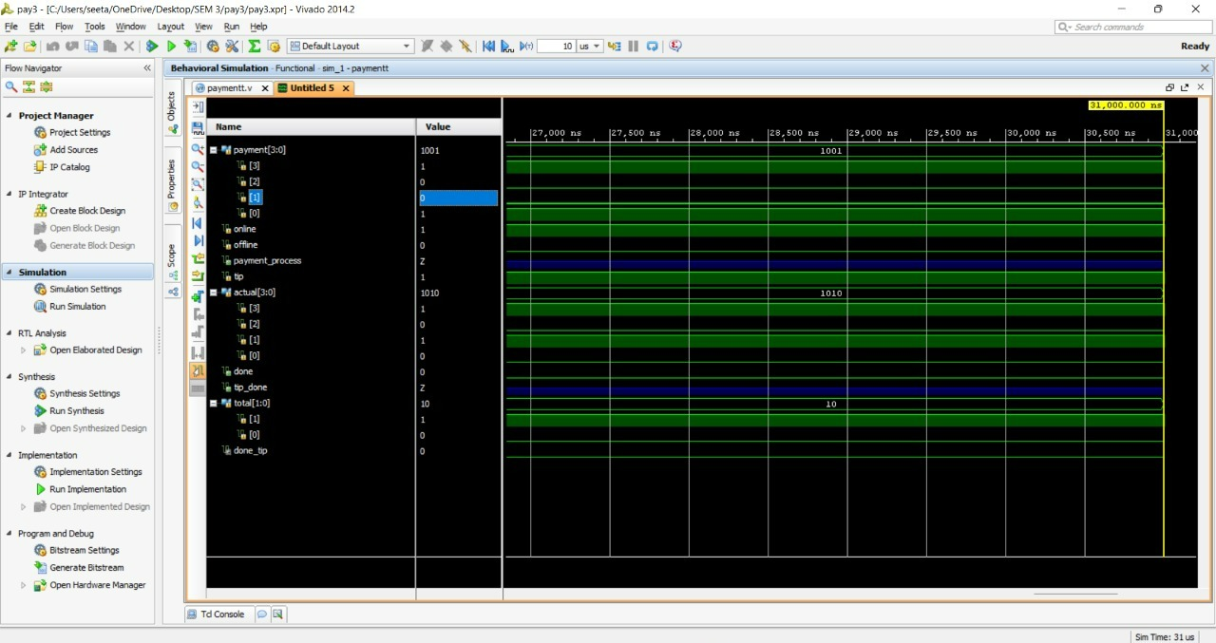

Slide 37
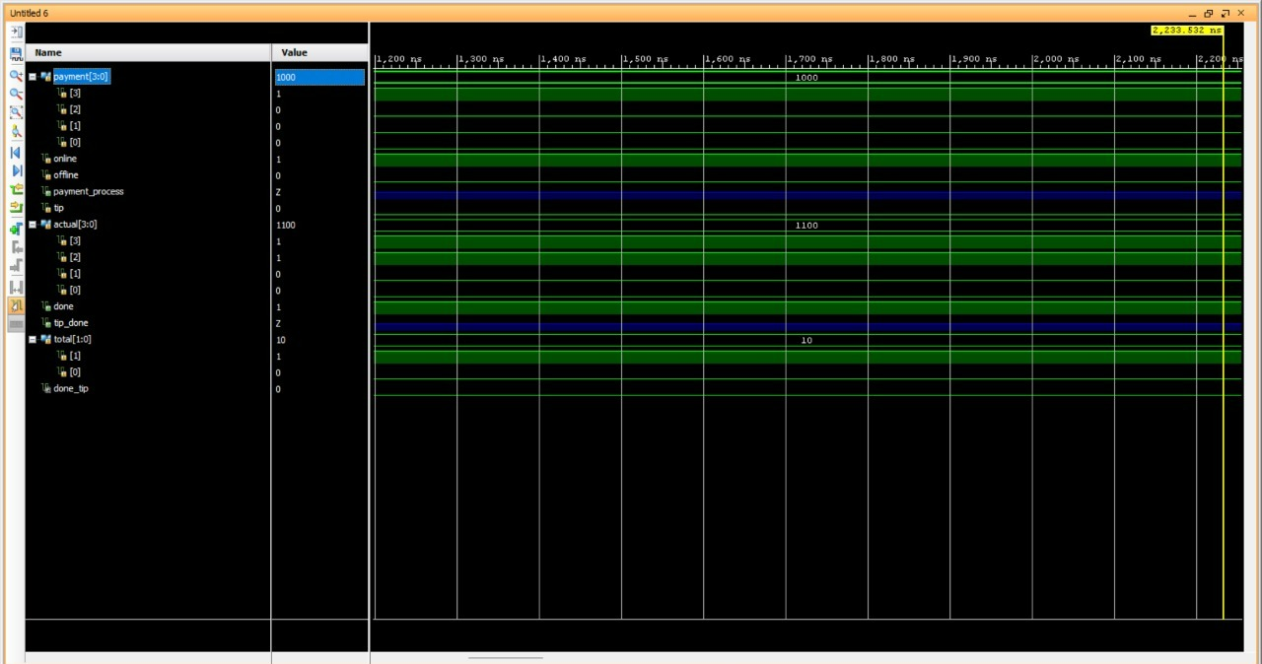

Slide 38
CONCLUSION
The proposed system would attract customers and also adds to the efficiency of maintaining the restaurant’s ordering and billing sections.
This system successfully overcomes the drawbacks of earlier automated food ordering systems and is less expensive as it requires a one-time investment for gadgets.
Online Food ordering system with features of feedback and wireless communication. This system is convenient, effective, and easy thereby improving the performance of restaurant staff. This system also ensures good quality of service and customer satisfaction.

Slide 39
REFERENCES:
-We got the inspiration to complete this project from observing the problems we face while ordering food in restaurants.
-We are thankful to all the professors who guided and helped us to make this project successful.
-Below are the platforms to learn Verilog better.
https://www.tutorialspoint.com/vlsi_design/vlsi_design_verilog_introduction.htm
https://www.javatpoint.com/verilog

Slide 40
THANK YOU!!!

